Slide 1



Title:
COFFEE BUSINESS POINT OF SALE AND PURCHASE INVENTORY MANAGEMENT SYSTEM USING C#.NET AND MS ACCESS DATABASE
BSCS 2B ~ Biaco ~ Embile ~ Lansangan ~ Merantes ~ Orias ~ Reyes
System Fundamentals ~ Prof. Cherry Rose Concha

Slide 2
ABSTRACT
In this paper, we describe the “Coffee Business Point of Sale and Purchase Inventory Management System using C#.net and MS Access Database”
This paper discusses the new and improved version of a current developed system that was presented before. These new improvements make’s the new system more presentable and user friendly than the first version.
This new system can be use based on its functions and added anew function that was needed on a Coffee Business System

Slide 3
INTRODUCTION
There are many points of sale advantages and benefits for your business, especially when compared to traditional cash registers. If your business still uses an Electronic Cash Register (ECR) and a credit card terminal, at some point you’ve probably considered upgrading to a complete Point of Sale (POS) system. However, if you’ve been hesitant in the past, there’s no better time than now to upgrade. POS systems are easier to use and more cost-effective than ever before. With a PO
Increased Efficiency
Ease of Use
Greater Accuracy
Inventory Management
Employee Management
Reporting

Slide 4
II. REVIEW OF RELATED STUDIES
Maintaining Alignment over the Long-Term: Lessons from the Evolution of an Electronic Point of Sale System
Research in both the organizational and information systems areas suggests that aligning information systems and dimensions of the organization improves performance. However, the dynamic nature of both information systems and organizations makes a close alignment more an aspiration than a state. This paper examines alignment from the perspective of the management processes through which companies may achieve and sustain alignment in dynamic environments. In so doing they may also develop core capabilities in managing IS innovation, which enable sustained competitive advantage. The paper traces the evolution of alignment in a company that used information systems to develop the business in new strategic directions, and shows how semi-structures contributed to this.

Slide 5
THE IMPACT OF POINT-OF-SALE DATA INACCURACY AND INVENTORY RECORD DATA ERRORS
The presence or absence of error in point-of-sale (POS) data and inventory system records directly affects retailer performance. This study identifies various error sources in retail supply chains and studies the influence of inventory and POS (demand) errors in a simulated retail outlet according to fill rate and average inventory. Other things being equal, we find that inventory record error reduces fill rate more than demand error. This study adds further evidence to other studies that suggest the costs caused by errors in POS systems may be overstated.

Slide 6
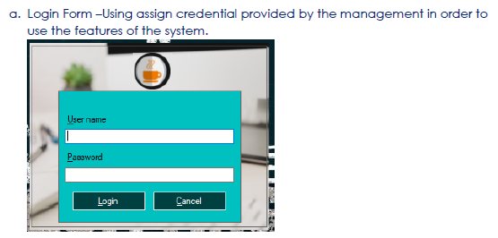
SYSTEM DEVELOPMENT

Slide 7
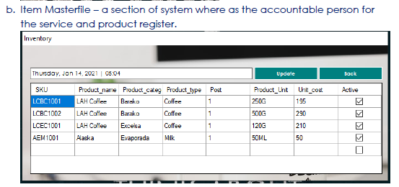
SYSTEM DEVELOPMENT

Slide 8
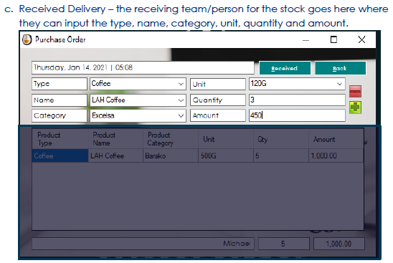
SYSTEM DEVELOPMENT

Slide 9
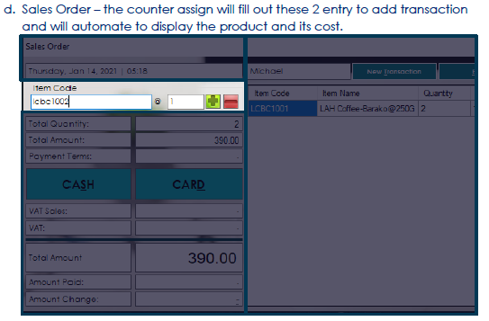
SYSTEM DEVELOPMENT

Slide 10


SYSTEM DEVELOPMENT

Slide 11







Thank You
Geoffrey Biaco
Developer
John Vincent Merantes
Developer
Mark Neil Embile
Developer
Clarence James Orias
Developer
Mark Steven Lansangan
Developer
Bobby Brandell Reyes
Developer

